Slide 1
Social Media Data Streaming
---- Kayla Liu

Slide 2
Contents
Data Collection
Data Model
Data Storage
Build Web Application

Slide 3


Social Media

Slide 4








Tools

Slide 5
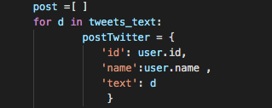



Data Model

Slide 6
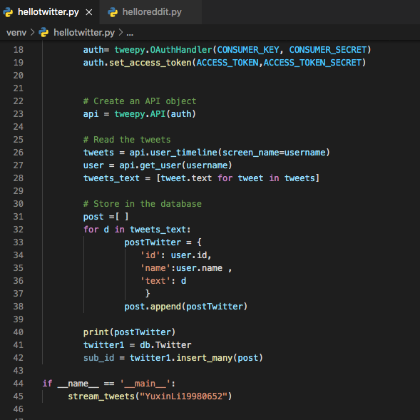
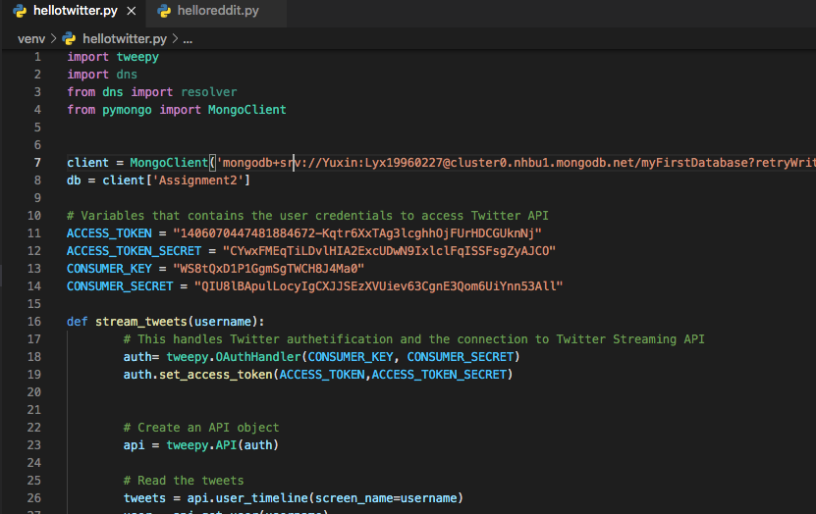
Data Collection - Twitter
REFERENCE: https://www.tweepy.org/

Slide 7
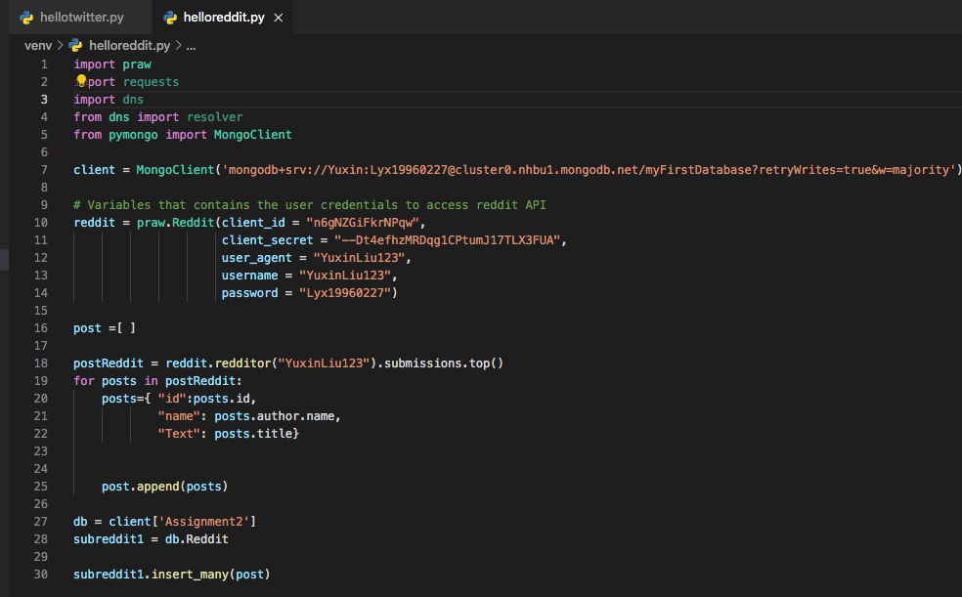
Data Collection - Reddit
REFERENCE: https://praw.readthedocs.io/en/latest/

Slide 8
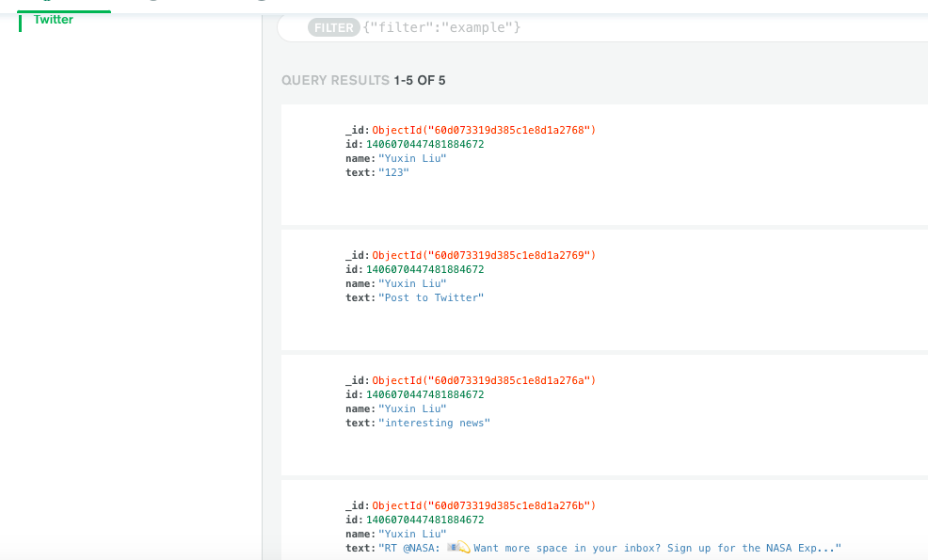
MongoDB- Twitter

Slide 9
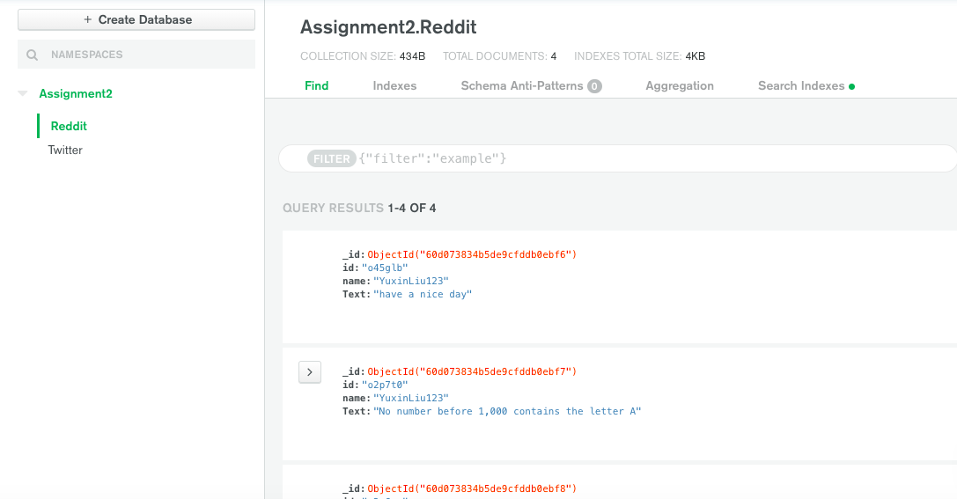
MongoDB- Reddit

Slide 10
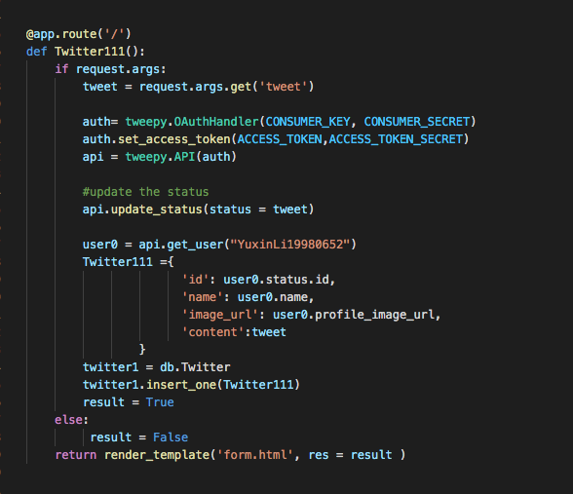
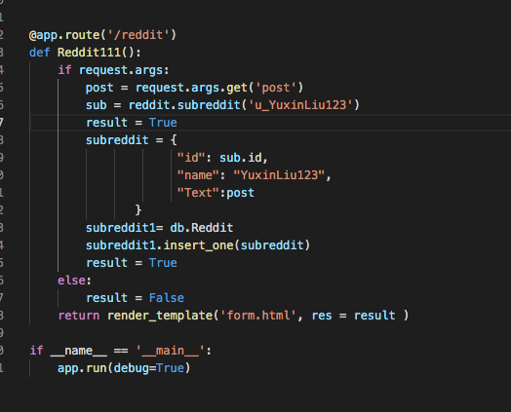
Web Application
REFERENCE: https://www.youtube.com/watch?v=9RAA845Gxn8

Slide 11
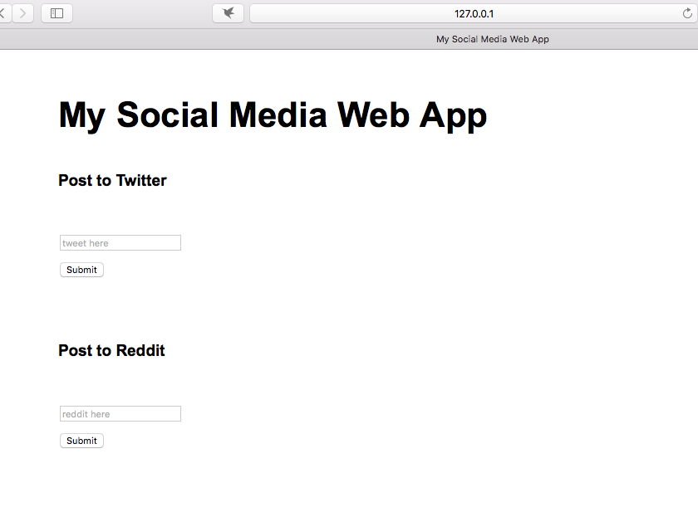
Web page

Slide 12
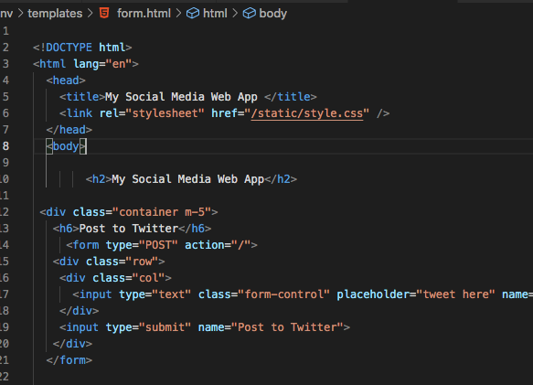
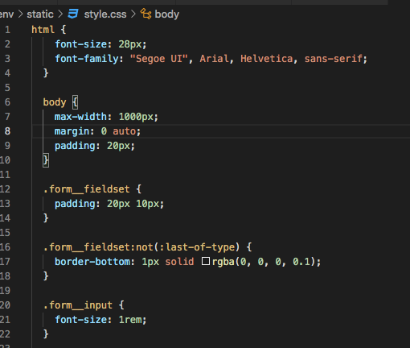
HTML/ CSS

Slide 13

Demo
Link to the presentation:
https://www.youtube.com/watch?v=tnehrrtb_Hc

Slide 14
THANKS

